Slide 1
Product Analytics Business Case
Andrew Siu
Notes:
- Today I will be presenting about the product analytics business case that was provided to me as part of the interview process

Slide 2
Background
The product team released a new product feature to a set of test clients three months ago
The new feature is designed to improve the workflow of the Coding and Appeal actions
Clients are now able to use the new product feature as well as the old legacy functionality
Notes:
Here is a little background information
Three months ago, the team released a new product feature to a set of test clients
The feature is an improvement to the legacy Coding and Appeal workflows
The clients now have the ability to use the new functionality as well as the legacy version
The definition of coding and appeals are in the appendix
Coding is when someone has to add a medical billing code to a claim for the patient services rendered
Appealing is when you receive a lower than expected payment for a claim and an appeal is made

Slide 3
Data
Set of clients that are categorized as:
  Small, medium, or large based on the size of the company
  Live or terminated
  Specialty of the client: dermatology, family medicine, OB-GYN, oncology, pediatrics, surgery
Weekly usage counts for Coding and Appeal actions for both new and legacy workflows over the past three months
Notes:
The data I have is from the past three months of clients that are categorized in certain groupings
These groupings are the size of the company (small, medium, large)
Status of the client (live or terminated)
Specialty of the client (dermatology, family medicine, OB-GYN, oncology, pediatrics, surgery)
We also have their weekly usage counts for the Coding and Appeal actions for the new and legacy workflows

Slide 4
Goal
Measure how clients are using new functionality
Propose metrics that can be used to track the success of the new functionality
Observe any trends and provide recommendations

Slide 5
Assumptions
Exclude clients that are labeled as terminated
All clients worked the same hours on Christmas and New Years day
  No increase or decrease in activity
Data is grouped by each week from 11/13/2017 to 1/8/2018
  Nine total weeks, five days a week
  Assume the data represents the entire week, no data for partial weeks
Assume there is no difference in usage for clients that do not have data for all weeks between 11/13/2017 to 1/8/2018
  Some clients only have data for one or two weeks instead of all nine for example
  They could possibly be new clients, but will look the data at face value
Notes:
Before we start, I have to provide some assumptions that I made for this data because this is a made up data set and there is no actual context around it
I excluded all clients that were labeled as terminated
The data included holidays such as Christmas and New Years so I am treating that as a normal work day
The data is grouped by weeks (5 work days)
I will also assume that there are no new clients that joined midway during this test
Some clients only have data for 1 or 2 weeks and I will not view them as new clients or else I might want to remove them from the dataset
But since this is a made up dataset, I want to keep it simple and not make the analysis more complex for a reason that might not actually be true

Slide 6
Utilization
~53% of clients utilized the new coding feature at least once
~45% of clients utilized the new appeal feature at least once
Notes:
The prompt asked to go over the client’s utilization of the new functionality
We can see that about 53% of clients used the new coding feature at least once within the 3 month timespan which is more than the new appeal feature which was used by about 45% of clients
We can also see that almost all clients are using the legacy coding action, but only about 2/3rd used the legacy appeal function
So the coding action is more commonly used than the appeal action

Slide 7
Utilization by Client Size
Medium sized clients have the highest utilization % for the new coding and appeals functionality
Small sized clients have lowest utilization % for the new coding and appeals functionality
Notes:
-Here we have utilization by client size
-When comparing the size of the client and their utilization rate, medium sized clients have the highest for both the new coding and appeal actions
-small clients have the lowest for both, but the utilization for the new coding is very similar between small and large clients (50% vs 51%)

Slide 8
Utilization by Client Specialty
Clients under the Pediatrics category have the highest utilization % for the new coding and appeals functionality
Clients under the OB-GYN category have the lowest utilization % for the new coding functionality
Clients under the Family Medicine category have the lowest utilization % for the new appeals functionality
Notes:
-Next, we have utilization by client specialty
-Pediatrics have the highest utilization for the new coding and appeal functions
-Family medicine has the lowest for the new appeal function and OB-GYN has the lowest for the new coding function, but it is very similar to family medicine (both 44%, but difference in decimal value)

Slide 9
Do larger clients have higher usage rates?
Depends on how you look at the data
  Having more data on different sized clients for each specialty would be beneficial
  With current data, larger clients that specialize in dermatology and surgery have a higher usage rate
Previous slide showed medium sized clients have the highest usage rates
New Coding
 | Dermatology | Family Medicine | OB-GYN | Oncology | Pediatrics | Surgery
Small | N/A | 0.44 | N/A | N/A | N/A | 0.53
Medium | 0.48 | N/A | 0.44 | N/A | 0.72 | 0.67
Large | 0.62 | N/A | N/A | 0.46 | N/A | N/A
New Appeal
 | Dermatology | Family Medicine | OB-GYN | Oncology | Pediatrics | Surgery
Small | N/A | 0.40 | N/A | N/A | N/A | 0.41
Medium | 0.33 | N/A | 0.44 | N/A | 0.58 | 0.54
Large | 0.55 | N/A | N/A | 0.42 | N/A | N/A
Notes:
So another question that was in the prompt was to check if larger clients have higher usage rates?
This question can be answered differently depending on how you look at the data
We can see in the charts below that most specialty categories have clients that are the same size. For example, clients that specialize in family medicine are all labeled as small clients.
Only Dermatology and Surgery have clients categorized into different sizes.
If we look at those clients, we can see that the larger sized clients have a higher utilization rate
But from the previous slide, we saw that medium sized clients had the highest usage for the new coding and appeal actions
It would be beneficial to have more data especially for different sized clients in each specialty if possible
That would help us come to a more definitive answer to this question

Slide 10
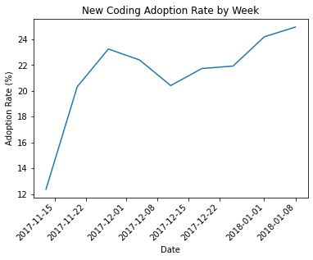
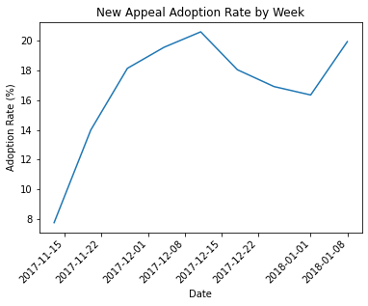

Metrics to track success – Adoption Rate
Adoption rate = $\frac{\text{Total} \text{Number} \text{of} \text{Unique} \text{Clients} \text{that} \text{Utilized} \text{the} \text{New} \text{Functionality} }{\text{Total} \text{Number} \text{of} \text{Unique} \text{Clients} }$
Notes:
The overview also asked to come up with two metrics that can track the success of the new functionality
The first metric we could use is adoption rate
This is taking the total number of unique clients that used the new functionality divided by the total number of unique clients in the dataset
We can display the adoption rate as a time series with the adoption rate each week
We saw earlier that the legacy coding function was used by almost every client in the dataset. Ideally we would want to see the adoption rate for the new coding functionality to be almost at 100%
We also saw that not all clients use the appeal function, so we would want to see this value reach a certain point and plateau around a certain range.

Slide 11
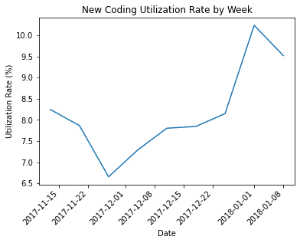
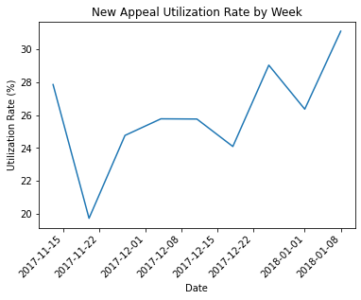

Metrics to track success – Utilization Rate
Utilization rate = $\frac{\text{Total} \text{Actions} \text{for} \text{New} \text{Function}}{\text{Total} \text{Actions}\text{ (}\text{New} \text{and} \text{Legacy})}$
Provides a different perspective compared to Adoption rate by client
Notes:
Another metric is utilization rate which is similar to what was shown earlier, but showing utilization of total actions instead of unique clients
It is taking the total count of new actions performed and dividing it by the total number of actions performed which includes the legacy actions
Higher percentages would mean less people are using the legacy function and we would want to see this value be 100% if we want clients to not use the legacy function at all
We can display this as a time series as well with the utilization rate for each week

Slide 12
Observations
The weekly utilization and adoption rate shows an upward trend for the previous three months
Can be considered successful depending on our expectations after three months of usage
  Adoption rate for new appeals is 15-20% while new coding is between 18-25%
  Utilization rate for new appeals is 20-30% while new coding is between 6-10%
We can compare the adoption rate of the legacy functionality and with the adoption rate of the new functionality
Notes:
Here are some observations that were made from the slides above
There is an upward trend in utilization and adoption rate of the new functionality for the previous three month’s data.
Would be curious to see if that trend continues in the next few months
The new function could be considered successful depending on what the initial expectations were
It does seem to be trending in the right direction, but more data and deeper analysis will be needed
There does seem to be a gap in the adoption rate between the legacy and new functions so we can take a look at this in the next slide

Slide 13
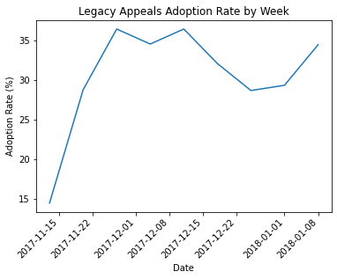
Comparing adoption rate - Appeals
The adoption rate of the new appeal functionality is closer to the legacy functionality compared to the new coding functionality
Notes:
The adoption rate of the new appeal function is between 10-15% lower than the legacy function.
This is a lot smaller gap compared to the coding actions

Slide 14
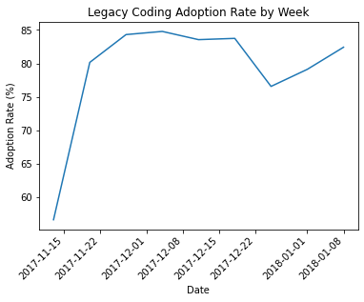
Comparing adoption rate - Coding
Large gap in adoption rate between legacy coding and new coding functionality
Notes:
The adoption rate for the new coding action is a lot lower than the legacy version
Are there certain characteristics of the new coding action that makes it difficult to make the switch?
Is the new appeals action more similar to the legacy version compared to the new and old coding function?
If there is a huge difference in the new and legacy coding actions, some people might not want to try it out at all
We know that almost all clients used the legacy coding action atleast once in the past 3 months, so that means many of them did not test out the new coding action when they had a chance to use it

Slide 15
Recommendations
I would not recommend expanding the new functionality to all clients until we investigate why there is such a large gap in adoption rate between new and legacy coding actions
  Is there something about the design that is causing the lower adoption rate?
  Is the design intuitive if you are experienced with the legacy functionality? If not, are there enough training materials for the clients?
  Collect another one or two months of data and see if it changes
Would recommend the product education team to focus their efforts on the new coding functionality and observe if that increases the adoption rate
  Could expand to more clients to observe its effectiveness, but not all
Collect additional data
  Survey data rating the new functionality vs. old functionality
  If possible, total time it takes to complete each action and calculate average time of legacy vs. new
  If possible, more clients of each size for each specialization
Notes:
I wouldn’t recommend expanding the new functionality to all clients until there is some more investigation on the large gap between the new and legacy coding function
Could be something with the design or not having the proper training materials for the clients to be comfortable using it
I would recommend the product education team to focus on creating the training materials for the new coding functionality and see if that helps increase the adoption rate
I would also like to collect some additional data from clients if it is possible.
I would like to see some kind of survey go out to the clients who had the chance to test the new functions and see what they think about it and rate different aspects of the function
Another possibility would be to collect data on the time it takes to complete each action and then see if there is a difference in time spent.
Could use this as a way to get more clients to adopt the new functionality
I would also want to collect data on more clients of different sizes within each of the specializations

Slide 16
Questions?

Slide 17
Appendix
Coding – adding a medical billing code to a claim for the patient services rendered
Appeal – appealing a claim for a lower than expected payment

